Slide 1

METAPHOR DETECTION
CSCI 57800
Group - 3

Slide 2
MODEL
In our project, we implemented 5 different models to get the accuracy of the dataset.
The models are:
Logistic Regression
Naïve Bayes Classifier
Support Vector Machine
Random Forest
Neural Network (PyTorch)

Slide 3
Implementation
Initially, we have done feature extraction in this way:
Context Extraction for Target Words
Data Cleaning (cleaning the dataset by removing rows where the context extraction results in an empty string)
TF-IDF Feature Transformation (context column is transformed into numerical features using TF-IDF )
Next, we used the sklearn library to implement the previously specified models.
We used k–fold cross-validation and calculated the average accuracy for each model (5 – folds).

Slide 4
Neural – Network Implementation
We implemented the neural network to detect the metaphors separately from the previous models.
The model is instantiated with the number of input features.
Cross-entropy loss (nn.CrossEntropyLoss) is used which is suitable for binary classification tasks.
Stochastic Gradient Descent (SGD) optimizer is used with a learning rate of 0.01.
The training loop involves forwarding pass, loss computation, backpropagation, and optimization steps for a fixed number of epochs.

Slide 5
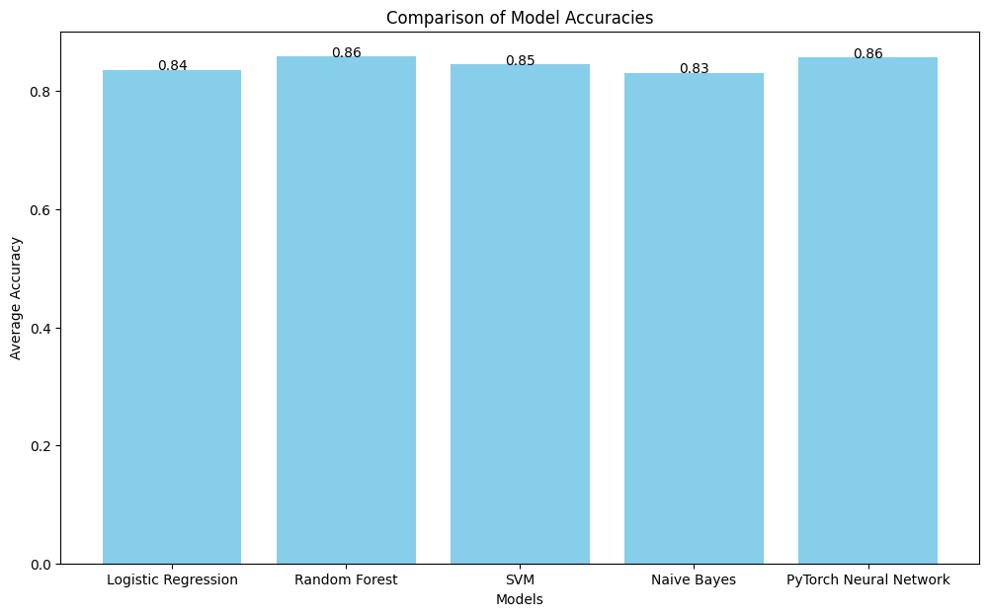
Results
After implementation, we get the accuracies for each model as shown in the figure.
Random Forest and Neural Network models obtain the highest accuracies of about 86%.

Slide 6
THANK YOU!!
JEEVAN REDDY MOTATI
PRIYANKA VOLETI
NARASIMHA ROHIT KATTA
GIRISH CHANDRA CHOUDHARY NANNURI

